Slide 1
Review Analysis
British Airways

Slide 2
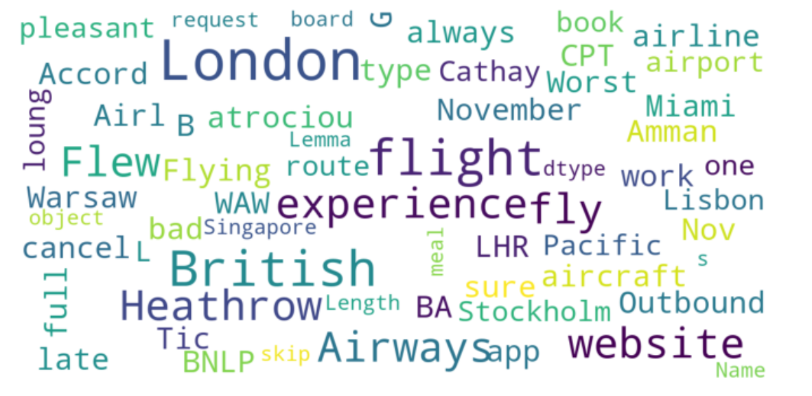
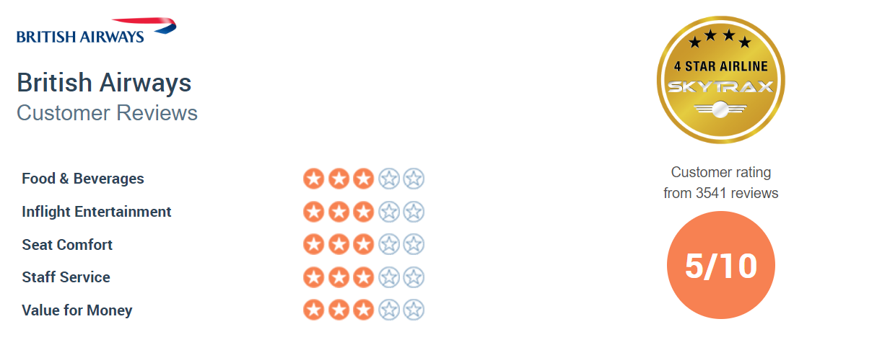
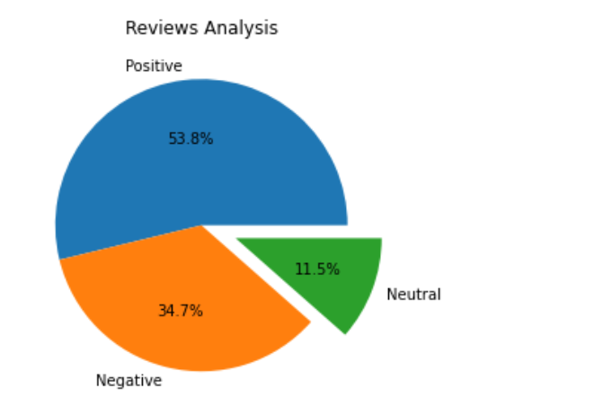
Insights based on Review Analysis
Based on our source British Airways
Source: Skytrax

